Slide 1

JUnit 5
A tool for describing and executing tests

Slide 2

Thomas Wheeler
@icanhavetweeter
www.linkedin.com/in/twheeler
thomas.wheeler@improving.com
Writing software for 25+ years in QA, technical support, and development roles.
Passionate about software craftsmanship, technical excellence and high performing teams - tools, techniques, and practices to enable individuals and teams to create high quality software.
Other: climbing, running, martial arts, …

Slide 3
JUnit Quick Intro
A tool for describing and executing tests
Tests are described using annotations: @Test, @BeforeEach, @Nested…
Tests are executed using a test execution framework
JUnit can be used for different kinds of testing: unit, integration/service, UI…

Slide 4
JUnit 5 – Major Changes / Improvements
Completely new architecture – separate APIs for writing tests (test API), discovering and running tests for that API (Test Engine); and the platform launcher
Extensions – a defined mechanism (API) for plugging in custom behavior
Support for Java 8 lambdas
Improved parameterized tests
Nested test classes
New annotations
Parameters for test constructors and methods

Slide 5
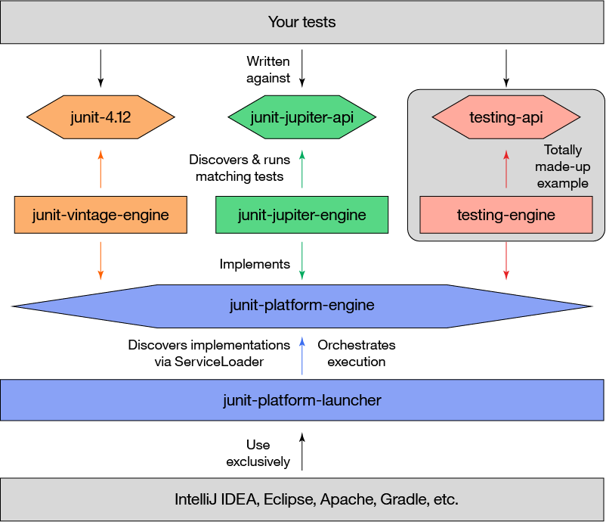
Notes:
JUnit 4’s monolithic architecture prevented the development of JUnit as a tool.
JUnit 5 – separate Test API, test discovery and execution, and launcher.

Slide 6
Comparing JUnit 4 and 5
JUnit 5 requires at least Java 8
New package! org.junit.jupiter.api
Annotations
Some changed names such as: @BeforeClass -> @BeforeAll; @Category -> @Tag; @After -> @AfterEach, @Ignore -> @Disabled
Some new annotations: @TestFactory, @TestInstance, @TestTemplate, @DisplayName, @Nested, @ExtendWith, @RepeatedTest

Slide 7
Comparing JUnit 4 and 5: Assertions
Mostly the same, one assertion (assertThat) dropped and two added:
assertAll – assert several conditions
assertThrows – assert that an exception is thrown
Message parameter is now last instead of first
assertEquals(1, 1, "Uh oh…")
Message parameter can be provided by a Supplier<String> and lazily evaluated
assertEquals(1, 1, () -> "Uh oh…")

Slide 8
JUnit 5 New Feature – Extensions
Purpose: provide a standard Extension API for extending the behavior of test classes or methods
Replaces JUnit4 test runners and rules
Extension points for
Test instance post-processing – After an instance of a test is created
Conditional test execution – Determine whether a test should be run
Life-cycle callbacks – Before/after all, before/after test invocation, before/after test method
Parameter resolution – Providing parameters to test constructors/methods
Exception handling – Custom handling of exceptions thrown during test execution

Slide 9
JUnit 5 New Feature – Lambda Support
Standard assertion methods:
assertEquals(1, 1, () -> “This message is lazily evaluated”)
Grouped assertions (new feature):
assertAll(“person”,
() -> assertEquals(“John”, person.getFirstName()),
() -> assertEquals(“Hancock”, person.getLastName())
);
Also: exceptions and timeouts

Slide 10
JUnit 5 New Feature – Nested Test Classes
Must be a non-static inner class
Can nest arbitrarily deep
@DisplayName(“A stack“) class StackTest { Stack<Object> testObject; @Test ... @Nested @DisplayName(“after pushing an element“) class AfterPushing { @Test ... } }

Slide 11
Gradle Setup
buildscript { repositories { mavenCentral() }
dependencies { classpath 'org.junit.platform:junit-platform-gradle-plugin:1.0.1’ } }
apply plugin: ‘org.junit.platform.gradle.plugin’
sourceCompatibility = 1.8
dependencies { testCompile('org.junit.platform:junit-platform-launcher:1.0.1’) testCompile('org.junit.jupiter:junit-jupiter-api:5.0.1’) testRuntime('org.junit.jupiter:junit-jupiter-engine:5.0.1’) // only required if running JUnit 4 tests testCompile("junit:junit:4.12") testRuntime("org.junit.vintage:junit-vintage-engine:4.12.1") }

Slide 12
Converting from JUnit 4 -> JUnit 5
Use the JUnit Vintage Test Engine to run existing JUnit 4 tests
JUnit 4 and JUnit 5 tests can exist in the same project
Different packages
Different test engines
Same launcher
Create new tests using JUnit 5
Migrate existing tests as time/opportunity permits

Slide 13
Unit Testing and TDD
Unit Testing because…
It’s a better way to prove the code behaves as you think (assume) it does
Refactoring security blanket: provides confidence that refactoring didn’t change behavior
Improve the design: composable building blocks
TDD because…
I can clearly define what I’m doing next
I know when to stop coding [part of] a feature
I can design/write the code from the perspective of its actual client
Reduce cognitive overhead and separate development concerns using the red/green/refactor cycle
Break work down into bite-sized chunks
Notes:
TDD: What am I building next? When do I know I’m done? What is the design (API) of the thing I am building? Red-Green-Refactor
Unit Testing: NOT about finding defects
tl;dr Unit Testing / TDD results in better (design/maintainability/readability/correctness) code more quickly

Slide 14
Unit Testing and TDD
Not a silver bullet – it will not automagically make your code great
Beware of cargo cult testing; don’t follow rules blindly
We must have 100% code coverage
Every (method | class) must be unit tested
The benefits of unit testing are correlated with the complexity of the code under test (design, algorithmic)
Best value: non-trivial logic with few dependencies
TDD requires a completely different mindset and habits; takes time to learn
Good design required (SOLID, GRASP, SPOT, DRY)
NOT about finding and correcting defects
Very not about achieving 100% correctness

Slide 15
TDD / Unit Testing Best Practices
Live by red-green-refactor. Refactor mercilessly.
A test should have one logical assertion. (There may be multiple assert statements.)
A specific logical behavior should be tested in one test.
Test suite run as part of CI build. Failures are addressed immediately.
Unit test small, independent units. Use integration/UI testing for “wire it all up and let it run” testing.
Mock out all external services and state: filesystem, database, REST/SOAP service.
Name your tests well. (Using @DisplayName is not a substitute.)
Treat test code as a first-class citizen: SOLID, DRY etc. all apply.

Slide 16
Some Unit Testing Mistakes/Smells
Rely on implementation details
Access private data
Method used only by test code (dead code)
Provide no value
Tests that could only fail if there is a compiler bug
Tests for coding mistakes that are easily found during code review
Tests on auto-generated code (e.g. getters/setters)
Tests on code that doesn’t belong to you (library/framework code)
Unit tests that aren’t actually a unit test
Integration/Service/UI test
Non-repeatable / fails randomly
Doesn’t actually assert anything in the real code
Accesses anything external to the code (file, socket, process…)
Takes a long time to run (> a few millis)
Assert several (usually unrelated) things about SUT
Structure is not Arrange/Act/Assert
[Excessive] use of mocking tools
Dependent on environment (works only in QA, CI build…)
Dependent on ‘hidden’ test data (located or initialized far away from test)
Depends on another test
Excessive setup code (more than a handful of lines)
Weak naming
Asserts values from an object far away from SUT
Test code treated as a second-class citizen
Notes:
Really: why people end up not using Unit Tests / TDD

Slide 17
Some Resources
http://junit.org/junit5/docs/current/user-guide/
https://www.ibm.com/developerworks/library/j-introducing-junit5-part1-jupiter-api/index.html
https://blog.codefx.org/design/architecture/junit-5-architecture/
http://www.baeldung.com/junit-5
https://www.petrikainulainen.net/programming/testing/junit-5-tutorial-running-unit-tests-with-gradle/
https://dzone.com/articles/unit-testing-means-end
https://stackoverflow.com/questions/67299/is-unit-testing-worth-the-effort/67500#67500
http://blog.stevensanderson.com/2009/11/04/selective-unit-testing-costs-and-benefits/
http://blog.stevensanderson.com/2009/08/24/writing-great-unit-tests-best-and-worst-practises/
http://wiki.c2.com/?TenYearsOfTestDrivenDevelopment
https://henrikwarne.com/2014/09/04/a-response-to-why-most-unit-testing-is-waste/
https://rbcs-us.com/documents/Why-Most-Unit-Testing-is-Waste.pdf
https://rbcs-us.com/documents/Segue.pdf
https://stackoverflow.com/questions/333682/unit-testing-anti-patterns-catalogue

